Slide 1


Boosting DNN Cold Inference on Edge Devices
Rongjie Yi¹, Ting Cao², Ao Zhou¹, Xiao Ma¹, Shangguang Wang¹, Mengwei Xu¹
¹ State Key Laboratory of Networking and Switching Technology ²Microsoft Research
Notes:
Hello, every one, My name is RONGJIE YI from State Key Laboratory of Networking and Switching Technology.
Today, I will share with you our recent work “boosting DNN cold inference on edge devices”.
##补充图标

Slide 2


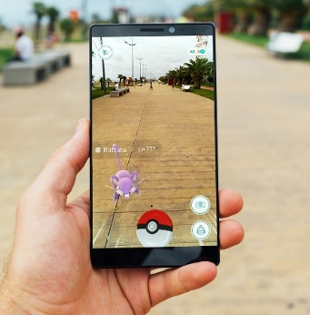
DNN is indispensable for mobile apps
Face recognition
Voice recognition
Augmented Reality
Notes:
Deep Neural Networks have become indispensable for mobile applications such as face recognition, Voice recognition, AR

Slide 3

DNN is indispensable for mobile apps
Face recognition
Voice recognition
Augmented Reality
DNN-embedded apps on Google Play
Notes:
Recently, there are hundreds of DNN embedded apps on Google Play.

Slide 4

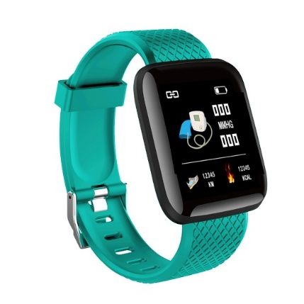
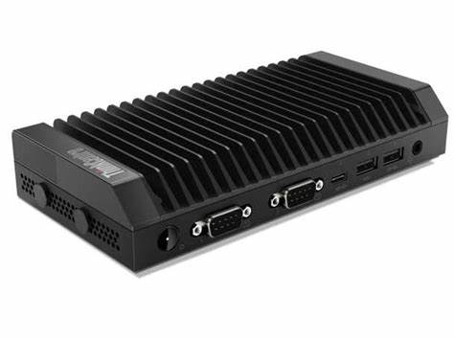
DNN is indispensable for mobile apps
Face recognition
Voice recognition
Augmented Reality
Deploy
smartphones
IoTs
wearables
Notes:
Pursuing low inference delay and data privacy, DNN deployment is shifting from large data centers to edge devices
Such as smartphones, IoT, wearables, and autonomous vehicles.

Slide 5
Challenges of deploying DNNs on devices
Notes:
Deploying DNNs on devices brings two challenges unpresented on datacenters.

Slide 6
Challenges of deploying DNNs on devices
The tightly constrained hardware resources
Notes:
The First One is the tightly constrained hardware resources.

Slide 7
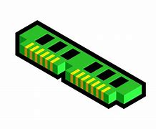


Challenges of deploying DNNs on devices
The tightly constrained hardware resources
memory
compute
energy
To obtain more accurate DNN inference results on devices with limited memory
Notes:
Such as memory, compute, energy and so on.
In respond, our community has invested amount of researches to obtain more accurate DNN inference results on devices with limited memory.

Slide 8
Challenges of deploying DNNs on devices
The tightly constrained hardware resources
The volatile, multi-tenant(app) runtime environment
Notes:
The second one is the volatile, multi-tenant runtime environment
which fundamentally differs from datacenters who typically host a single DNN service on GPU clusters .

Slide 9
Challenges of deploying DNNs on devices
The tightly constrained hardware resources
The volatile, multi-tenant(app) runtime environment
For devices with limited memory,
It’s inevitable to switch between multiple DNN inference.
DNNs cannot always reside in device memory.
Notes:
For devices with limited memory, It’s inevitable to switch between multiple DNN inference
So DNNs cannot always reside in device memory;

Slide 10
Challenges of deploying DNNs on devices
The tightly constrained hardware resources
The volatile, multi-tenant(app) runtime environment
For devices with limited memory,
It’s inevitable to switch between multiple DNN inference.
DNNs cannot always reside in device memory.
DNN inference often occurs in cold inference manner
Notes:
Above all, the DNN inference often occurs in cold inference manner,

Slide 11
What is cold inference?
load and initialize the model weights into memory before execution.
Notes:
Cold inference means load and initialize the model weights into memory before execution.

Slide 12
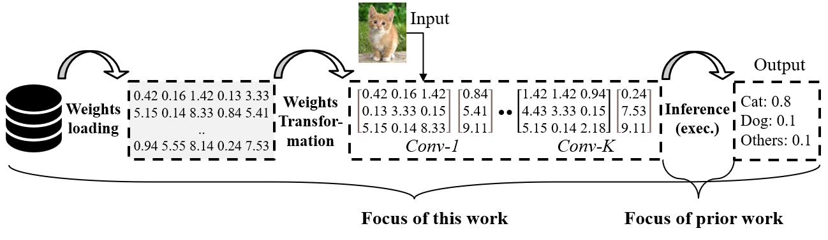
What is cold inference?
load and initialize the model weights into memory before execution.
Cold inference
Warm inference
Notes:
And warm inference only refers to execution.
Different with prior work who focus on warm inference, our work focus on the cold inference.
## 简化图

Slide 13
DNN cold inference’s classification
Notes:
In general, on-device DNN cold inference could occur in both active and passive manners.

Slide 14
DNN cold inference’s classification
Active Cold Inference
Developers avoids a model residing in memory for a long time.
Notes:
Active cold inference happens per developers’ willingness.
By design, developers often avoids a model residing in memory for a long time to reduce memory footprint.

Slide 15
DNN cold inference’s classification
Active Cold Inference
Developers avoids a model residing in memory for a long time.
Mobile apps re-launch models that are infrequently used.
Notes:
mobile apps always re-launch DNNs that are infrequently used to reduce its memory usage and thus the probability being killed after moved to background

Slide 16



DNN cold inference’s classification
Active Cold Inference
Developers avoids a model residing in memory for a long time.
Mobile apps re-launch models that are infrequently used.
PDF Scanner
Beauty Camera
Voice Assistant
Notes:
We observe many such cases from the Google Play apps:
For example ,PDF scanner always re-launch its’ OCR model when scanning is needed

Slide 17
DNN cold inference’s classification
Active Cold Inference
Developers avoids a model residing in memory for a long time.
Mobile apps re-launch models that are infrequently used.
Pack all DNNs into device memory through weights sharing
Notes:
The common approach is to pack all DNNs into device memory through weights sharing to avoid cold inference.

Slide 18
DNN cold inference’s classification
Active Cold Inference
Developers avoids a model residing in memory for a long time.
Mobile apps re-launch models that are infrequently used.
Pack all DNNs into device memory through weights sharing
Unscalable
Notes:
However, these methods are not scalable, Because as the number of models increases, accuracy decreases

Slide 19
DNN cold inference’s classification
Active Cold Inference
Passive Cold Inference
Notes:
Passive cold inference happens out of the control of developers.

Slide 20

DNN cold inference’s classification
Active Cold Inference
Passive Cold Inference
Mobile Phone OS kills background apps to reduce memory footprint
Mobile Phone OS
Notes:
When memory doesn’t permit, Mobile Phone OS kills background apps to reduce memory footprint.

Slide 21

DNN cold inference’s classification
Active Cold Inference
Passive Cold Inference
Mobile Phone OS kills background apps to reduce memory footprint
Mobile Browsers relaunch a model whenever web pages are opened
Mobile Browsers
Notes:
Even if memory permits, cold inference still occurs.
For example, mobile browsers need to relaunch a DNN model whenever certain web pages are opened such as language translation.

Slide 22

DNN cold inference’s classification
Active Cold Inference
Passive Cold Inference
Mobile Phone OS kills background apps to reduce memory footprint
Mobile Browsers relaunch a model whenever web pages are opened
DNN-based software could crash and needs to fast re-launch.
Autonomous Driving
Notes:
By the way, a DNN-based software could crash and needs to fast re-launch.

Slide 23
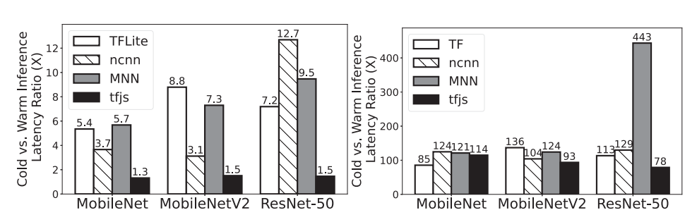
Cold inference is poorly supported
Google Pixel 5 CPU
Jetson TX2 GPU
Huge gap between cold/warm Inference latency hurt the user experience.
Notes:
Unfortunately, the state-of-the-art DNN engines are not ready to boost cold inference as fast as warm inference.
We measured the cold inference latency and warm inference latency of those engines on embedded CPU and GPU, and show the latency ratio.
Such huge gap will hurt the user experience.

Slide 24
Cold inference breakdown
Notes:
We then breakdown the cold inference process.
While different DNN engines differ in implementation, their cold inference mainly includes the following stages

Slide 25

Cold inference breakdown
1.Weights loading
0.42 0.16 1.42 0.13 3.33
5.15 0.14 8.33 0.84 5.41
..
0.94 5.55 8.14 0.24 7.53
device storage
memory
Reading the model weights from device storage into memory
Notes:
The Weights leading stage reading the model weights from device storage into memory

Slide 26

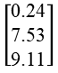
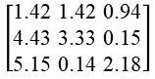
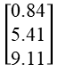
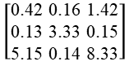
Cold inference breakdown
1.Weights loading
2.Weights Transformation
depends on the kernel implementation for each operator.
0.42 0.16 1.42 0.13 3.33
5.15 0.14 8.33 0.84 5.41
..
0.94 5.55 8.14 0.24 7.53
$$\left[\begin{aligned}\text{0.42 0.16 1.42} \\ \text{0.13 3.33 0.15} \\ \text{5.15 0.14 8.33}\end{aligned}\right]$$
$$\left[\begin{aligned}\text{0.84} \\ \text{5.41} \\ \text{9.11}\end{aligned}\right]$$
Conv-1:
...
device storage
memory
Conv-K :
$$\left[\begin{aligned}\text{1.42 1.42 0.94} \\ \text{4.43 3.33 0.15} \\ \text{5.15 0.14 2.18}\end{aligned}\right]$$
$$\left[\begin{aligned}\text{0.24} \\ \text{7.53} \\ \text{9.11}\end{aligned}\right]$$
Converting raw weights into the proper format to facilitate the inference
Notes:
Weights transformation stage converting raw weights into the proper format to facilitate the inference.
This process depends on the kernel implementation for each operator.

Slide 27
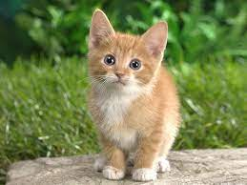
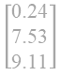
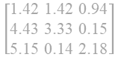
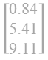
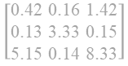
Cold inference breakdown
Input
3.Inference (execution)
1.Weights loading
2.Weights Transformation
Output
depends on the kernel implementation for each operator.
0.42 0.16 1.42 0.13 3.33
5.15 0.14 8.33 0.84 5.41
..
0.94 5.55 8.14 0.24 7.53
$$\left[\begin{aligned}\text{0.42 0.16 1.42} \\ \text{0.13 3.33 0.15} \\ \text{5.15 0.14 8.33}\end{aligned}\right]$$
$$\left[\begin{aligned}\text{0.84} \\ \text{5.41} \\ \text{9.11}\end{aligned}\right]$$
Cat: 0.8
Dog: 0.1
Others: 0.1
Conv-1:
...
device storage
memory
Conv-K :
$$\left[\begin{aligned}\text{1.42 1.42 0.94} \\ \text{4.43 3.33 0.15} \\ \text{5.15 0.14 2.18}\end{aligned}\right]$$
$$\left[\begin{aligned}\text{0.24} \\ \text{7.53} \\ \text{9.11}\end{aligned}\right]$$
The actual inference process by invoking each operator of the model
Notes:
Model execution stage is the actual inference process by invoking each operator of the model

Slide 28
Cold inference breakdown
Input
3.Inference (execution)
1.Weights loading
2.Weights Transformation
Output
depends on the kernel implementation for each operator.
0.42 0.16 1.42 0.13 3.33
5.15 0.14 8.33 0.84 5.41
..
0.94 5.55 8.14 0.24 7.53
$$\left[\begin{aligned}\text{0.42 0.16 1.42} \\ \text{0.13 3.33 0.15} \\ \text{5.15 0.14 8.33}\end{aligned}\right]$$
$$\left[\begin{aligned}\text{0.84} \\ \text{5.41} \\ \text{9.11}\end{aligned}\right]$$
Cat: 0.8
Dog: 0.1
Others: 0.1
Conv-1:
...
device storage
memory
Conv-K :
$$\left[\begin{aligned}\text{1.42 1.42 0.94} \\ \text{4.43 3.33 0.15} \\ \text{5.15 0.14 2.18}\end{aligned}\right]$$
$$\left[\begin{aligned}\text{0.24} \\ \text{7.53} \\ \text{9.11}\end{aligned}\right]$$

Slide 29
Cold inference breakdown
A breakdown of ResNet-50 cold inference latency on edge CPU and GPU.
Device Platform | Google Pixel 5 | Jetson TX2
Processor | CPU | GPU
Weights loading | 37.86ms | 46.72ms
Weights Transformation | 1135.28ms | 4620.85ms
Execution | 190.12ms | 802.77ms
Total cold inference | 1363.23ms | 5467.48ms
Warm inference | 185.82ms | 137.02ms
Notes:
This table shows the breakdown of ResNet-50 cold inference latency
On both CPU and GPU, each stage contributes to a considerable portion of the slow cold inference.
To obtain an acceptable cold inference latency, we need to optimize each of the above stages

Slide 30
How to speedup cold inference?
Notes:
But How to speedup cold inference?
We find three optimization knobs .

Slide 31
Optimization Knobs#1: Kernel selection
A DNN model can be represented as a directed data graph consisting of many operators.
Kernels represent the different implementation of an operator
Notes:
The first Optimization Knobs is Kernel selection
A DNN model can be represented as a directed data graph consisting of many operators.
The kernels represent the different implementation of an operator.

Slide 32
Optimization Knobs#1: Kernel selection
A DNN model can be represented as a directed data graph consisting of many operators.
Kernels represent the different implementation of an operator
One operator, many kernels:
e.g. Convolution Operator’s Kernels:
Kernels | Cold Inference Time (ms)
 | Load Weights | Weights Trans. | Execution
3x3s1-winograd-pack4 | 0.70 | 38.23 | 2.98
sgemm-pack4 | 0.70 | 2.21 | 8.14
pack4 | 0.70 | 2.22 | 18.63
3x3s1-winograd | 0.70 | 65.67 | 3.37
3x3s1 | 0.70 | 0.00 | 8.01
general | 0.70 | 0.00 | 87.12
Notes:
Based on observation, Each operator has many kernels
For example, This table shows the latency of different kernels of Convolution Operator.

Slide 33
Optimization Knobs#1: Kernel selection
The current kernel selection policy:
hard-coded
only considers the warm inference speed
Our new kernel selection policy:
Automatic
be optimal for cold inference
Notes:
The current kernel selection policy of popular DNN engines is hard-coded and only considers the warm inference speed,
However, such selection may not be optimal for cold inference.
So, our kernel selection automatically considers all stages of cold inference.

Slide 34
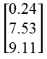
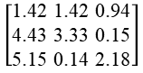
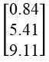
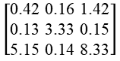
Optimization Knobs#2: Bypassed weights transformation
Weights loading
Weights Transformation
0.42 0.16 1.42 0.13 3.33
5.15 0.14 8.33 0.84 5.41
..
0.94 5.55 8.14 0.24 7.53
Conv-1:
$$\left[\begin{aligned}\text{0.42 0.16 1.42} \\ \text{0.13 3.33 0.15} \\ \text{5.15 0.14 8.33}\end{aligned}\right]$$
$$\left[\begin{aligned}\text{0.84} \\ \text{5.41} \\ \text{9.11}\end{aligned}\right]$$
...
device storage
Conv-K :
$$\left[\begin{aligned}\text{1.42 1.42 0.94} \\ \text{4.43 3.33 0.15} \\ \text{5.15 0.14 2.18}\end{aligned}\right]$$
$$\left[\begin{aligned}\text{0.24} \\ \text{7.53} \\ \text{9.11}\end{aligned}\right]$$
Notes:
The second Optimization Knobs is Bypassed weights transformation.
the weights transformation for some kernels can be extremely costly, even the kernel executes fast.

Slide 35
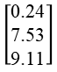
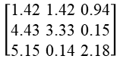
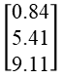
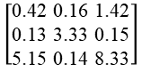
Optimization Knobs#2: Bypassed weights transformation
Weights loading
Weights Transformation
0.42 0.16 1.42 0.13 3.33
5.15 0.14 8.33 0.84 5.41
..
0.94 5.55 8.14 0.24 7.53
Conv-1:
$$\left[\begin{aligned}\text{0.42 0.16 1.42} \\ \text{0.13 3.33 0.15} \\ \text{5.15 0.14 8.33}\end{aligned}\right]$$
$$\left[\begin{aligned}\text{0.84} \\ \text{5.41} \\ \text{9.11}\end{aligned}\right]$$
...
device storage
Conv-K :
$$\left[\begin{aligned}\text{1.42 1.42 0.94} \\ \text{4.43 3.33 0.15} \\ \text{5.15 0.14 2.18}\end{aligned}\right]$$
$$\left[\begin{aligned}\text{0.24} \\ \text{7.53} \\ \text{9.11}\end{aligned}\right]$$
Cache
Weights loading
Conv-1:
$$\left[\begin{aligned}\text{0.42 0.16 1.42} \\ \text{0.13 3.33 0.15} \\ \text{5.15 0.14 8.33}\end{aligned}\right]$$
$$\left[\begin{aligned}\text{0.84} \\ \text{5.41} \\ \text{9.11}\end{aligned}\right]$$
...
device storage
Conv-K :
$$\left[\begin{aligned}\text{1.42 1.42 0.94} \\ \text{4.43 3.33 0.15} \\ \text{5.15 0.14 2.18}\end{aligned}\right]$$
$$\left[\begin{aligned}\text{0.24} \\ \text{7.53} \\ \text{9.11}\end{aligned}\right]$$
Notes:
One possible method to avoid the heavy transformation is to cache the transformed weights on disk, which can be directly loaded and executed.
This method remove the weights transformation time in cold inference, however, could also introduce additional disk storage.
So our system will decide whether to adipate it according to the cold inference latency.

Slide 36
Optimization Knobs#3: Pipelined inference
Edge devices are typically equipped with multi-process architecture
e.g. Arm big.LITTLE architecture:
”LITTLE” processors are designed for maximum power efficiency.
“big” processors are designed to provide efficient compute performance.
Notes:
The Third optimization knobs is pipeline inference.
Nowadays edge devices are typically equipped with multi-process architecture such as big.LITTLE technology.
Many ARM devices use this architecture.

Slide 37
Optimization Knobs#3: Pipelined inference
Edge devices are typically equipped with multi-process architecture
e.g. Arm big.LITTLE architecture:
”LITTLE” processors are designed for maximum power efficiency.
“big” processors are designed to provide efficient compute performance.
Multi-Thread the kernel preparation and execution
Notes:
To fully exploit those processors to boost cold inference, one might simply multi-thread the kernel preparation and execution,
For example, using many threads to read and transform the weights at the same time.

Slide 38
Optimization Knobs#3: Pipelined inference
Weights loading: bounded by disk I/O.
Weights Transformation: bounded by memory I/O.
Execution: bounded by computation.
Notes:
But multi-threading are limited due to two reasons.
First, weights loading and transformation stages are not bounded by the computation but disk I/O and memory I/O.
Second, the asymmetric multi-processor on edge devices makes it difficult to partition the workloads to fully utilize each processor’s capacity.

Slide 39
Optimization Knobs#3: Pipelined inference.
Weights loading: bounded by disk I/O.
Weights Transformation: bounded by memory I/O.
Execution: bounded by computation.
Pipelined inference
Notes:
So we propose to pipeline them by overlap different kernels’ weights loading, transformation, and execution.

Slide 40

NNV12: design overview
Decision stage
Optimization Knobs
Kernel selection
Kernel Scheduler
Bypassing weights transformation
Deployed
DNN
…
Inference pipeline
Online Inference Runtime
Generated kernel scheduling plan
little CPU cores
Inference data
big CPU cores, GPU,etc
Cached post-transformed weights and shader(GPU)
Execution order
Execution stage
Notes:
Base on these three Optimization Knobs,
We design the NNV-12: a DNN inference framework for boosting cold inference.
NNV12 contains design stage and execution stage.
In decision stage, Kernel Scheduler generate an kernel scheduling plan and cache the post-transformed weights and shaders.
This stage runs fully automatically on device for one shot
In execution stage, NNV12 follows the generated plan to optimize the cold inference at runtime.
From developers, NNV12 is like traditional DNN inference frameworks in deployment.
## 转折

Slide 41
NNV12: design overview
Decision stage
Optimization Knobs
Kernel selection
Kernel Scheduler
Bypassing weights transformation
How to design kernel scheduler?
Deployed
DNN
…
Inference pipeline
Online Inference Runtime
Generated kernel scheduling plan
little CPU cores
Inference data
big CPU cores, GPU,etc
Cached post-transformed weights and shader(GPU)
Execution order
Execution stage
Notes:
In the next section, I will introduce how to design kernel scheduler

Slide 42
Problem Formulation
The need for a kernel scheduler:
Which kernel to use for each operator;
Whether to load the raw weights or the cached post-transformed weights for each kernel;
When and where to execute each operation.
Notes:
First of all ,we should know the needs:
which kernel to use for each operator;
whether to load the raw weights or the cached post-transformed weights for each kernel;
when and where to execute each operation.

Slide 43
Problem Formulation
Use term operation to indicate each stage of operators kernel:
weights loading operation;
weights transformation operation;
execution operation.
e.g. operator 1 can be indicate:
Load operation 1;
Transformation operation 1;
Execution operation 1.
Notes:
In this work, we use the term operation to indicate each stage of a kernel,
weights reading, transformation, and execution are three different operations.

Slide 44
Problem Formulation
Kernel Scheduler Output:
Notes:
Then we will introduce the outputs of kernel scheduler

Slide 45
Problem Formulation
Kernel Scheduler Output:
Generated kernel scheduling plan
Load operation i
i
Little CPU core 1
2
2
4
4
Transformation operation i
i
…
…
Execution operation i
i
Little CPU core k
3
3
Big CPU cores / GPU
1
1
1
2
3
4
Execution order
Notes:
The first one is Generated kernel scheduling plan
The kernel scheduling plan shows the Execution order of operations run on each processors.

Slide 46
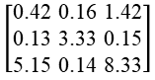
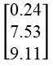
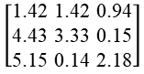
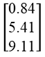
Problem Formulation
Kernel Scheduler Output:
Generated kernel scheduling plan
Cached post-transformed weights and shader(GPU)
Cached shaders
(only for GPU)
Cached weights
Conv-1:
$$\left[\begin{aligned}\text{0.42 0.16 1.42} \\ \text{0.13 3.33 0.15} \\ \text{5.15 0.14 8.33}\end{aligned}\right]$$
$$\left[\begin{aligned}\text{0.84} \\ \text{5.41} \\ \text{9.11}\end{aligned}\right]$$
Conv-1:
shader-1
...
...
Conv-K :
$$\left[\begin{aligned}\text{1.42 1.42 0.94} \\ \text{4.43 3.33 0.15} \\ \text{5.15 0.14 2.18}\end{aligned}\right]$$
$$\left[\begin{aligned}\text{0.24} \\ \text{7.53} \\ \text{9.11}\end{aligned}\right]$$
Conv-K :
shader-K
Notes:
The second one is Cached post-transformed weights.
for GPU devices, we also cached the shaders which is generated in the weight transformation stage like cached weights.

Slide 47
Heuristic-Based Kernel Scheduler
Heuristic and Assumptions
Notes:
Based on some heuristics, we build our algorithm atop the three key assumptions.

Slide 48
Heuristic-Based Kernel Scheduler
Heuristic and Assumptions
Each kernel’s execution operation executed sequentially.
Load operation i: no precursor operations
Transformation operation i’s precursor operation:
Load operation i
Execution operation i’s precursor operation:
Transformation operation i & Execution operation i-1
Notes:
Firstly, Each kernel’s execution operation executed sequentially.
Each operation should executed after it’s precursor operations.
Load operation has no precursor operations
Transformation operation has one precursor operation
Execution operation has at least two precursor operations

Slide 49
Heuristic-Based Kernel Scheduler
Heuristic and Assumptions
Each kernel’s execution operation executed sequentially.
Each kernel’s execution operation always occupies all big cores/GPU .
Notes:
Secondly, Each kernel’s execution operation always occupies all big CPU cores or GPU.

Slide 50
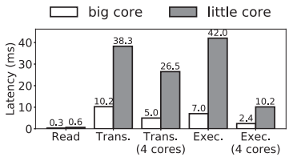
Heuristic-Based Kernel Scheduler
Heuristic and Assumptions
Each kernel’s execution operation executed sequentially.
Each kernel’s execution operation always occupies all big cores/GPU .
The consumed time of different stages of cold start on different ARM core types and numbers.
Notes:
We measured The consumed time of different stages of cold start on different ARM core types and numbers.
according to results, the speedup of multithreading on kernel execution can almost linearly scale with the number of cores,
but multithreading gets poor performance on weights loading and transformation.
This is because multithreading is more friendly to computation-intensive operations.

Slide 51
Heuristic-Based Kernel Scheduler
Heuristic and Assumptions
Each kernel’s execution operation executed sequentially.
Each kernel’s execution operation always occupies all big cores/GPU .
Executing execution operation on LITTLE cores could easily bottleneck the whole inference, leaving the big cores under-utilized.
Notes:
Hus executing execution operation on LITTLE cores could easily bottleneck the whole inference, leaving the big cores under-utilized.
And the SOTA DNN inference engines such as ncnn and tflite also execute their inference on big CPU cores for ARM devices.
So this assumption is critical to push the performance of cold inference to the limit of warm inference

Slide 52
Heuristic-Based Kernel Scheduler
Heuristic and Assumptions
Each kernel’s execution operation executed sequentially.
Each kernel’s execution operation always occupies all big cores/GPU .
Load and transformation operations of the same kernel are always bundled together.
Transformation operation i’s precursor operation: Load operation i
Notes:
Thirdly, Load and transformation operations of the same kernel are always bundled together.
This is reasonable that each Transformation operation executes after its’ precursor load operation.
Since execution operation occupies all big cores, we can use many little cores to run those operations at the same time.

Slide 53
Heuristic-Based Kernel Scheduler
Algorithm of kernel scheduling
Notes:
Base on these three Assumptions, we design the Algorithm of kernel scheduling.

Slide 54
Heuristic-Based Kernel Scheduler
Algorithm of kernel scheduling
little core 1
2 | 2 | 3 | 3 | 4 | 4 | 5 | 5 | 6 | 6 | 7 | 7 | 8 | 8 | 9 | 9
Load operation
big cores/GPU
1
1
1 | 2 | 3 | 4 | 5 | 6 | 8 | 9
Transformation operation
Execution order
Execution operation
Measure the latency of operation
Notes:
Firstly, we will Measure the latency of operation run on corresponding processors.

Slide 55
Heuristic-Based Kernel Scheduler
Algorithm of kernel scheduling
little core 1
2 | 2 | 3 | 3 | 4 | 4 | 5 | 5 | 6 | 6 | 7 | 7 | 8 | 8 | 9 | 9
Load operation
big cores/GPU
1
1
1 | 2 | 3 | 4 | 5 | 6 | 8 | 9
Transformation operation
Execution order
Execution operation
little core 1
little core 2
little core 3
little core 4
5 | 5 | 9 | 9
4
4
8
8
3 | 3 | 7 | 7
2 | 2 | 6 | 6
big cores/ GPU
1 | 1 | 1 | 2 | 3 | 4
5
6 | 7 | 8
9
1
5
6
8
9
Init the kernel scheduling plan
Notes:
Then we initialize the kernel scheduling plan

Slide 56
Heuristic-Based Kernel Scheduler
Algorithm of kernel scheduling
little core 1
2 | 2 | 3 | 3 | 4 | 4 | 5 | 5 | 6 | 6 | 7 | 7 | 8 | 8 | 9 | 9
Load operation
big cores/GPU
1
1
1 | 2 | 3 | 4 | 5 | 6 | 8 | 9
Transformation operation
Execution order
Execution operation
little core 1
little core 2
little core 3
little core 4
5 | 5 | 9 | 9
5
5
5 | 5 | 7 | 7
5 | 5 | 7 | 7
4
4
8
8
4
4
8
8
4
4
8
8
3 | 3 | 4 | 4 | 8 | 8
3 | 3 | 7 | 7
3 | 3 | 7 | 7 | 9 | 9
3 | 3 | 9 | 9
9
9
2 | 2 | 6 | 6
2 | 2 | 6 | 6
2 | 2 | 6 | 6
2 | 2 | 6 | 6
big cores/ GPU
1 | 1 | 1 | 2 | 3 | 4
5
6 | 7 | 8
9
1 | 1 | 1 | 2 | 3 | 4
5
6 | 7 | 8 | 9
1 | 1 | 1 | 2 | 3 | 4
5 | 6 | 7 | 8
9
1 | 1 | 1 | 2 | 3 | 4
5 | 6 | 7
8
9
1
5
6
8
9
Adjusting the scheduling plan on the little CPU cores through loops
Notes:
Next ,the Algorithm Adjust the scheduling plan on the little CPU cores through loops,

Slide 57
Heuristic-Based Kernel Scheduler
Algorithm of kernel scheduling
little core 1
2 | 2 | 3 | 3 | 4 | 4 | 5 | 5 | 6 | 6 | 7 | 7 | 8 | 8 | 9 | 9
Load operation
big cores/GPU
1
1
1 | 2 | 3 | 4 | 5 | 6 | 8 | 9
Transformation operation
Execution order
Execution operation
little core 1
little core 2
little core 3
little core 4
5 | 5 | 9 | 9
5
5
5 | 5 | 7 | 7
5 | 5 | 7 | 7
4
4
8
8
4
4
8
8
4
4
8
8
3 | 3 | 4 | 4 | 8 | 8
3 | 3 | 7 | 7
3 | 3 | 7 | 7 | 9 | 9
3 | 3 | 9 | 9
9
9
2 | 2 | 6 | 6
2 | 2 | 6 | 6
2 | 2 | 6 | 6
2 | 2 | 6 | 6
big cores/ GPU
1 | 1 | 1 | 2 | 3 | 4
5
6 | 7 | 8
9
1 | 1 | 1 | 2 | 3 | 4
5
6 | 7 | 8 | 9
1 | 1 | 1 | 2 | 3 | 4
5 | 6 | 7 | 8
9
1 | 1 | 1 | 2 | 3 | 4
5 | 6 | 7
8
9
1
5
6
8
9
6
6
6
6
3 | 3 | 6 | 6
5 | 5 | 9 | 9
9
9
9
9
4
4
8
8
4
4
8
8
4 | 4 | 8 | 8
3 | 3 | 7 | 7
3 | 3 | 5 | 5 | 7 | 7
5 | 5 | 7 | 7
1 | 1 | 2 | 2 | 1 | 2 | 3 | 4 | 5 | 6 | 7 | 8
9
1 | 1 | 2 | 2 | 1 | 2 | 3 | 4
5 | 6 | 7 | 8 | 9
1 | 1 | 2 | 2 | 1 | 2 | 3 | 4 | 5 | 6 | 7 | 8 | 9
Adjust the scheduling plan through loops so that the total latency on the big CPU cores/GPU and small CPU cores is similar
Notes:
And Adjust the scheduling plan through loops so that the total latency on the big CPU cores or GPU and small CPU cores is similar

Slide 58
Heuristic-Based Kernel Scheduler
Algorithm of kernel scheduling
little core 1
2 | 2 | 3 | 3 | 4 | 4 | 5 | 5 | 6 | 6 | 7 | 7 | 8 | 8 | 9 | 9
Load operation
big cores/GPU
1
1
1 | 2 | 3 | 4 | 5 | 6 | 8 | 9
Transformation operation
Execution order
Execution operation
little core 1
little core 2
little core 3
little core 4
5 | 5 | 9 | 9
5
5
5 | 5 | 7 | 7
5 | 5 | 7 | 7
4
4
8
8
4
4
8
8
4
4
8
8
3 | 3 | 4 | 4 | 8 | 8
3 | 3 | 7 | 7
3 | 3 | 7 | 7 | 9 | 9
3 | 3 | 9 | 9
9
9
2 | 2 | 6 | 6
2 | 2 | 6 | 6
2 | 2 | 6 | 6
2 | 2 | 6 | 6
big cores/ GPU
1 | 1 | 1 | 2 | 3 | 4
5
6 | 7 | 8
9
1 | 1 | 1 | 2 | 3 | 4
5
6 | 7 | 8 | 9
1 | 1 | 1 | 2 | 3 | 4
5 | 6 | 7 | 8
9
1 | 1 | 1 | 2 | 3 | 4
5 | 6 | 7
8
9
1
5
6
8
9
6
6
6
6
3 | 3 | 6 | 6
3 | 3 | 6 | 6
5 | 5 | 9 | 9
9
9
9
9
output
9
9
4
4
8
8
4
4
8
8
4 | 4 | 8 | 8
4 | 4 | 8 | 8
3 | 3 | 7 | 7
3 | 3 | 5 | 5 | 7 | 7
5 | 5 | 7 | 7
5 | 5 | 7 | 7
1 | 1 | 2 | 2 | 1 | 2 | 3 | 4 | 5 | 6 | 7 | 8
9
1 | 1 | 2 | 2 | 1 | 2 | 3 | 4
5 | 6 | 7 | 8 | 9
1 | 1 | 2 | 2 | 1 | 2 | 3 | 4 | 5 | 6 | 7 | 8 | 9
1 | 1 | 2 | 2 | 1 | 2 | 3 | 4 | 5 | 6 | 7 | 8 | 9
Output obtained: kernel scheduling plan
Notes:
Finally through these two kinds of loops, Algorithm will generate the output kernel scheduling plan,

Slide 59
Evaluation: setting
Model | Task | Parameters
AlexNet | classification | 61.3M
GoogLeNet |  | 7.1M
MobileNet |  | 4.4M
MobileNetV2 |  | 3.7M
ResNet18 |  | 12.7M
ShuffleNet |  | 3.6M
EfficientNetB0 |  | 5.4M
ResNet50 |  | 25.7M
SqueezeNet |  | 1.4M
ShuffleNetV2 |  | 3.4M
MobileNetv2-YOLOv3 | Object Detection | 3.6M
MobileNet-YOLO |  | 11.9M
CRNN-lite | OCR | 2.4M
Notes:
We implement NNV12 based on NCNN
And we evaluate its performance.
We choose thirteen models of three kinds of tasks which contains classification, detection and OCR.

Slide 60
Evaluation: setting
Device | SoC | little cores
Meizu 16T | Snapdragon 855 | 4
Google Pixel 5 | Snapdragon 765G | 2
Redmi 9 | MTK Helio G80 | 4
Meizu 18 Pro | Snapdragon 888 | 4
Device | GPU memory | little cores
Jetson TX2 | 8G | 2
Jetson Nano | 4G | 2
Notes:
And The evaluation devices contains four mobile phone and two jetson Edge devices

Slide 61
Evaluation: setting
Device | SoC | little cores
Meizu 16T | Snapdragon 855 | 4
Google Pixel 5 | Snapdragon 765G | 2
Redmi 9 | MTK Helio G80 | 4
Meizu 18 Pro | Snapdragon 888 | 4
Baselines:
ncnn
Tensorflow/TFLite
AsyMo^{[1]}
Device | GPU memory | little cores
Jetson TX2 | 8G | 2
Jetson Nano | 4G | 2
1. Wang et al. Asymo: scalable and efficient deep-learning inference on asymmetric mobile cpus. MobiCom’21
Notes:
we compare the performance of NNV12 to 3 baselines:
Ncnn and Tensorflow are the SOTA DNN frameworks.
The AsyMo can fully exploit the asymmetric CPU architecture on smartphones.

Slide 62
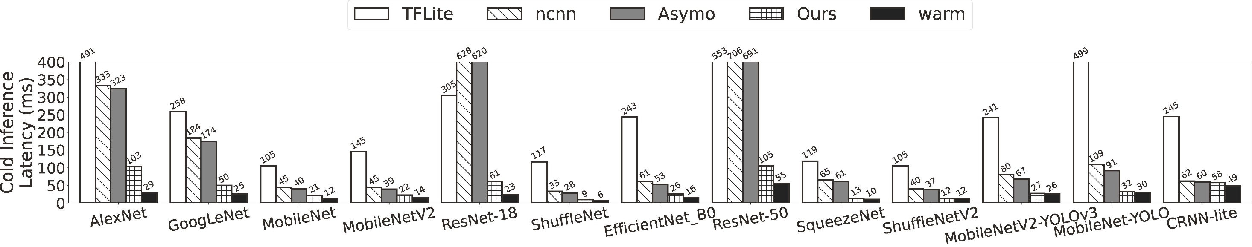
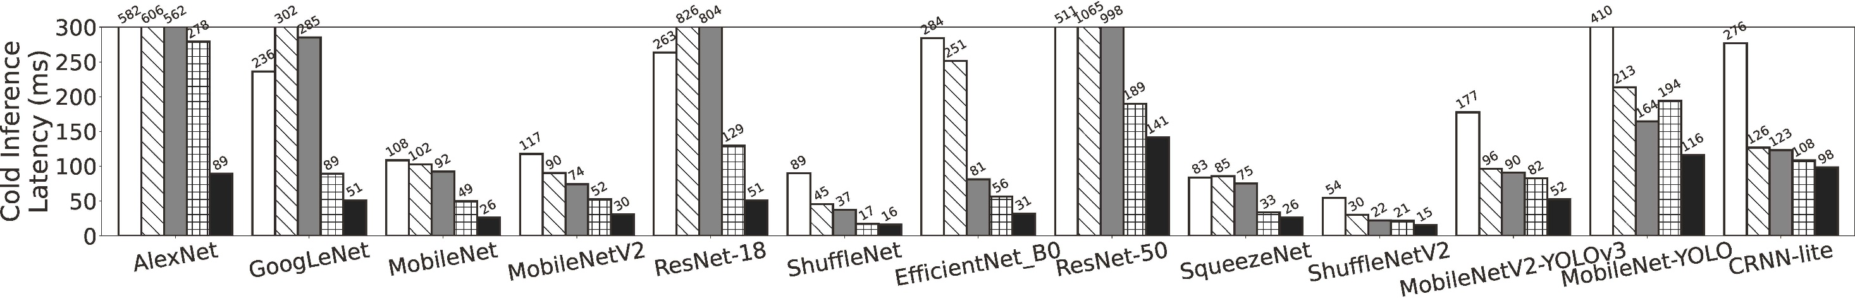
Evaluation: end-to-end performance
The cold inference latency of NNV12 and baselines on edge CPUs
Meizu 16T CPU
Google Pixel 5 CPU
Notes:
For end-to-end performance, we evaluate NNV12 and baselines on mobile phones.
#图不顶格

Slide 63
Evaluation: end-to-end performance
The cold inference latency on edge CPUs
Meizu 16T CPU
Google Pixel 5 CPU
Notes:
Experiment results show that NNV12 has lowest cold inference latency compared with baselines.
We take GoogleNet as an example.

Slide 64
Evaluation: end-to-end performance
The cold inference latency on edge CPUs
5.2x
Meizu 16T CPU
TFLite
NNV12
Google Pixel 5 CPU
Notes:
NNV12 achieves a speedup of 5.2 compared to TFLite.

Slide 65
Evaluation: end-to-end performance
The cold inference latency on edge CPUs
3.7x
Meizu 16T CPU
ncnn
NNV12
Google Pixel 5 CPU
Notes:
And achieves a speedup of 3.7 compared to NCNN.

Slide 66
Evaluation: end-to-end performance
The cold inference latency on edge CPUs
Cold inference up to 15.2× speedup over TFLite
Cold inference up to 10.3× speedup over ncnn
3.7x
Meizu 16T CPU
ncnn
NNV12
Google Pixel 5 CPU
Notes:
For all model and devices
NNV12 achieves a speedup up to 15.2 compared to TFLITE, and 10.3 compared to NCNN.

Slide 67
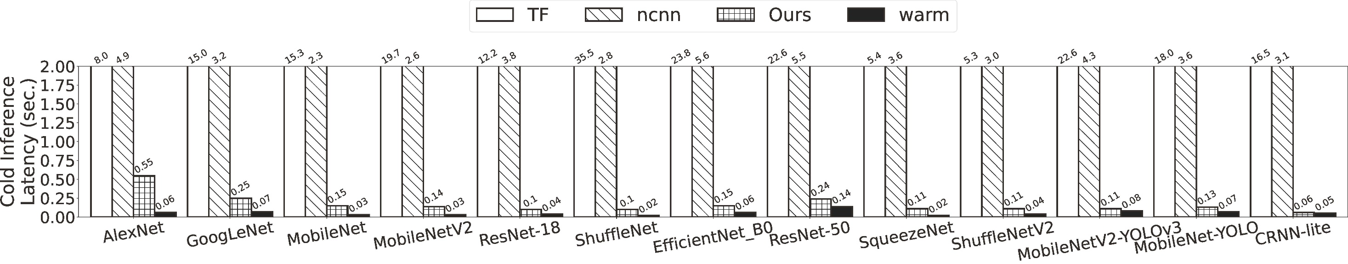
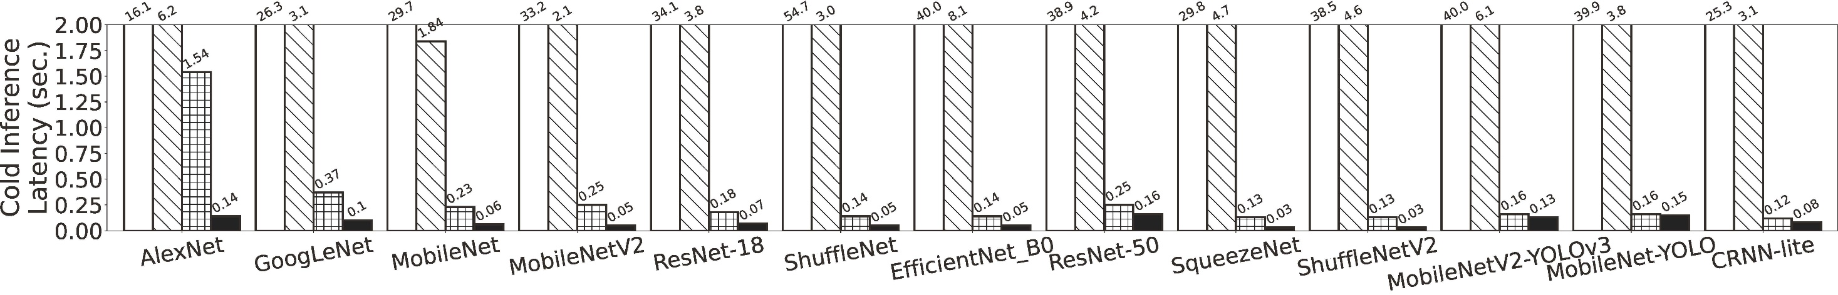
Evaluation: end-to-end performance
The cold inference latency on edge GPUs
Jetson TX2 GPU
Jetson Nano GPU
Notes:
Similarly, we also evaluate NNV12 and baselines on jetson edge devices And measures the end-to-end latency
#放大

Slide 68
Evaluation: end-to-end performance
The cold inference latency on edge GPUs
Cold inference up to 29.6× speedup over Tensorflow
Cold inference up to 234.3× speedup over ncnn
Jetson TX2 GPU
Jetson Nano GPU
Notes:
NNV12 achieves a speedup up to 29.6 compared to TFLITE, and 234.3 compared to NCNN.

Slide 69
Evaluation: end-to-end performance
Performance comparison
Platform | Speedup over baselines (avg)
Platform | ncnn | Tensorflow/TFLite
Meizu 16T (CPU) | 3.7x | 7.5x
Pixel 5 (CPU) | 2.8x | 2.2x
Redmi 9 (CPU) | 3.1x | 3.2x
Meizu 18 Pro (CPU) | 3.9x | 5.2x
Jetson TX2 (GPU) | 29.6x | 154.8x
Jetson Nano (GPU) | 28.5x | 234.3x
Notes:
We summarizes NNV12’s overall improvements.
NNV12 significantly outperforms the baselines ncnn and Tensorflow on all models and platforms
$$ 图删掉，结论放在上面图， 和warm的差距

Slide 70
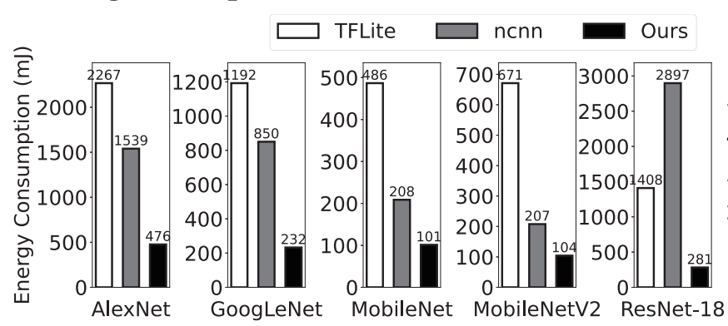
Evaluation: end-to-end performance
Reduce energy consumption by 1.6×-5.0×
Notes:
We evaluate the energy consumption of NNV12.
Compared with ncnn and TFLite, NNV12 can significantly reduce the energy consumption.

Slide 71
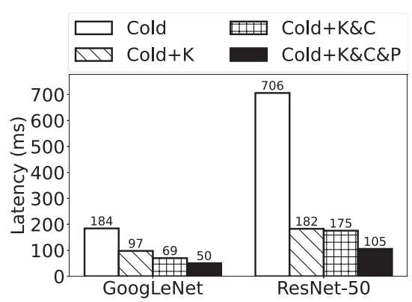
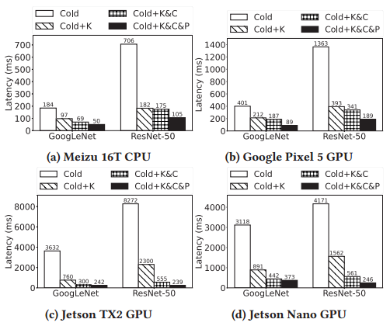
Evaluation: ablation
K: kernel selection;
C: caching the post-transformed weights (and shaders);
P: kernel execution pipeline
Notes:
We also evaluation the contribution of each component.
We take Googlnet and resnet-50 as example.
We can see that that each of NNV12’s key techniques contributes noticeably to the cold inference speedup.

Slide 72
Conclusion
NNV12: A DNN inference framework boosting DNN cold inference on devices
Implement a prototype and evaluate its efficiency
Open source: https://github.com/UbiquitousLearning/NNV12
Notes:
In conclusion, we proposed NNV12, a framework boosting DNN cold inference on devices.
We Implement a prototype and evaluate its efficiency
NNV12 is Open sourced, all the source code can be found here
## 补充

Slide 73

Thanks!
Boosting DNN Cold Inference on Devices
Rongjie Yi¹, Ting Cao², Ao Zhou¹, Xiao Ma¹, Shangguang Wang¹, Mengwei Xu¹
¹ State Key Laboratory of Networking and Switching Technology ²Microsoft Research
Code:https://github.com/UbiquitousLearning/NNV12
yirongjie@bupt.edu.cn
Notes:
Thank for listening, If you have any question, please contact me with this email address

